Slide 1
Natural Language Processing
Week 8

Slide 2
Good evening, everyone. Welcome to the live session.
Today, we will be practicing problems from the current week’s content.
We will wait 5 minutes for everyone to join in and start at 7:05 pm.

Slide 3
Assume that you are learning a classifier for the data-driven deterministic parsing and the sentence ‘I prefer ChatGPT course’ is a gold-standard parse in your training data. You are also given that ‘ChatGPT’ and ‘course’ are ‘Nouns’, ‘I’ is a ‘Pronoun’ while the POS tag of ‘prefer’ is ‘Verb’. Obtain the dependency graph for this sentence on your own. Assume that your features correspond to the following conditions:
1. The stack is empty.
2. Top of stack is Noun and Top of buffer is Verb.
3. Top of stack is Pronoun and Top of buffer is Verb.
4. The word at the top of stack occurs before word at the top of the buffer in the sentence
The initial weights of your features are [2,2,2,2 | 3,3,3,2| 2,2,2,2 | 2,2,2,2] where the first four features correspond to LA, and then to RA, SH and RE, respectively. Use this gold standard parse during online learning. What will be the weights after completing two iteration of Arc-Eager parsing over this sentence:

Slide 4
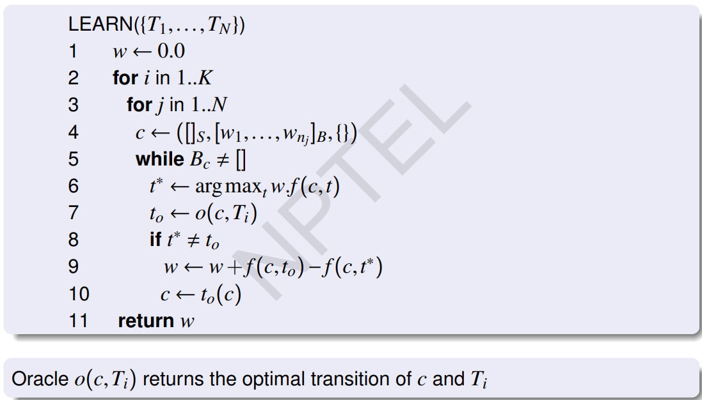

Slide 5
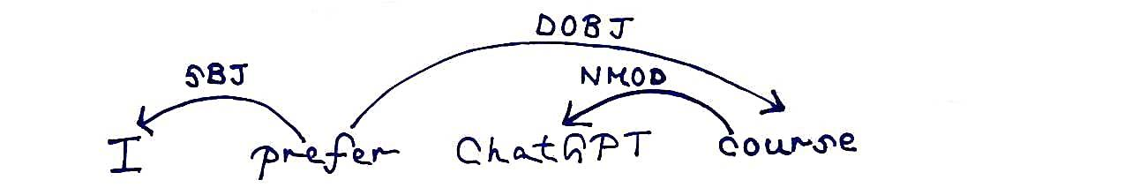
Solution
Given - The first four features correspond to LA, and then to RA, SH and RE, respectively.
f(c,t) = [c₁&&LA, c₂&&LA, c₃&&LA, c₄&&LA | c₁&&RA, c₂&&RA, c₃&&RA, c₄&&RA | c₁&&SH, c₂&&SH, c₃&&SH, c₄&&SH | c₁&&RE, c₂&&RE, c₃&&RE, c₄&&RE]
Initial weight: w = [2,2,2,2 | 3,3,3,2| 2,2,2,2 | 2,2,2,2]

Slide 6
Solution
Current configuration = []_{S}, [I,prefer,ChatGPT,course]_{B}, {}
Conditions: 1. The stack is empty. 2. Top of stack is Noun and Top of buffer is Verb. 3. Top of stack is Pronoun and Top of buffer is Verb. 4. The word at the top of stack occurs before word at the top of the buffer in the sentence.
f(c,t) = [c₁&&LA, c₂&&LA, c₃&&LA, c₄&&LA | c₁&&RA, c₂&&RA, c₃&&RA, c₄&&RA | c₁&&SH, c₂&&SH, c₃&&SH, c₄&&SH | c₁&&RE, c₂&&RE, c₃&&RE, c₄&&RE]
f(c,LA) = [ 1, 0, 0, 0 | 0, 0, 0, 0 | 0, 0, 0, 0 | 0, 0, 0, 0]
f(c,RA) = [ 0, 0, 0, 0 | 1, 0, 0, 0 | 0, 0, 0, 0 | 0, 0, 0, 0]
f(c,SH) = [ 0, 0, 0, 0 | 0, 0, 0, 0 | 1, 0, 0, 0 | 0, 0, 0, 0]
f(c,RE) = [ 0, 0, 0, 0 | 0, 0, 0, 0 | 0, 0, 0, 0 | 1, 0, 0, 0]

Slide 7
Solution
w = [2,2,2,2 | 3,3,3,2| 2,2,2,2 | 2,2,2,2]
w * f(c,LA) = w * [ 1, 0, 0, 0 | 0, 0, 0, 0 | 0, 0, 0, 0 | 0, 0, 0, 0] = 2
w * f(c,RA) = w * [ 0, 0, 0, 0 | 1, 0, 0, 0 | 0, 0, 0, 0 | 0, 0, 0, 0] = 3
w * f(c,SH) = w * [ 0, 0, 0, 0 | 0, 0, 0, 0 | 1, 0, 0, 0 | 0, 0, 0, 0] = 2
w * f(c,RE) = w * [ 0, 0, 0, 0 | 0, 0, 0, 0 | 0, 0, 0, 0 | 1, 0, 0, 0] = 2
t* = RA, t₀ = SH, t* ≠ t₀
w_{new} = w_{old} + f(c, t₀) - f(c,t*) = w_{old} + f(c, SH) - f(c,RA)
= [2,2,2,2 | 3,3,3,2| 2,2,2,2 | 2,2,2,2] + [ 0, 0, 0, 0 | 0, 0, 0, 0 | 1, 0, 0, 0 | 0, 0, 0, 0] - [ 0, 0, 0, 0 | 1, 0, 0, 0 | 0, 0, 0, 0 | 0, 0, 0, 0] = [2,2,2,2 | 2,3,3,2| 3,2,2,2 | 2,2,2,2]

Slide 8
Solution
Current configuration = [I]_{S}, [prefer,ChatGPT,course]_{B}, {}
Conditions: 1. The stack is empty. 2. Top of stack is Noun and Top of buffer is Verb. 3. Top of stack is Pronoun and Top of buffer is Verb. 4. The word at the top of stack occurs before word at the top of the buffer in the sentence.
f(c,t) = [c₁&&LA, c₂&&LA, c₃&&LA, c₄&&LA | c₁&&RA, c₂&&RA, c₃&&RA, c₄&&RA | c₁&&SH, c₂&&SH, c₃&&SH, c₄&&SH | c₁&&RE, c₂&&RE, c₃&&RE, c₄&&RE]
f(c,LA) = [ 0, 0, 1, 1 | 0, 0, 0, 0 | 0, 0, 0, 0 | 0, 0, 0, 0]
f(c,RA) = [ 0, 0, 0, 0 | 0, 0, 1, 1 | 0, 0, 0, 0 | 0, 0, 0, 0]
f(c,SH) = [ 0, 0, 0, 0 | 0, 0, 0, 0 | 0, 0, 1, 1 | 0, 0, 0, 0]
f(c,RE) = [ 0, 0, 0, 0 | 0, 0, 0, 0 | 0, 0, 0, 0 | 0, 0, 1, 1]

Slide 9
Solution
w = [2,2,2,2 | 2,3,3,2| 3,2,2,2 | 2,2,2,2]
w * f(c,LA) = w * [ 0, 0, 1, 1 | 0, 0, 0, 0 | 0, 0, 0, 0 | 0, 0, 0, 0] = 4
w * f(c,RA) = w * [ 0, 0, 0, 0 | 0, 0, 1, 1 | 0, 0, 0, 0 | 0, 0, 0, 0] = 5
w * f(c,SH) = w * [ 0, 0, 0, 0 | 0, 0, 0, 0 | 0, 0, 1, 1 | 0, 0, 0, 0] = 4
w * f(c,RE) = w * [ 0, 0, 0, 0 | 0, 0, 0, 0 | 0, 0, 0, 0 | 0, 0, 1, 1] = 4
t* = RA, t₀ = LA, t* ≠ t₀ w_{new} = w_{old} + f(c, t₀) - f(c,t*) = w_{old} + f(c, LA) - f(c,RA)
= [2,2,2,2 | 2,3,3,2| 3,2,2,2 | 2,2,2,2] + [ 0, 0, 1, 1 | 0, 0, 0, 0 | 0, 0, 0, 0 | 0, 0, 0, 0] - [ 0, 0, 0, 0 | 0, 0, 1, 1 | 0, 0, 0, 0 | 0, 0, 0, 0] = [2,2,3,3 | 2,3,2,1| 3,2,2,2 | 2,2,2,2]

Slide 10
Question 1:
Consider the following sentences:
1. I need to write an essay tonight to make sure I get everything right for the
upcoming exam.
2. Near the river bank, I sat on the grass and thought I need to visit the bank
to deposit a check today.
The lexical relation between the highlighted words in sentences 1, 2 are
a. Homophones, Homonymy
b. Homograph, Synonym
c. Homonymy, Homophones
d. Synonym, Hyponym

Slide 11
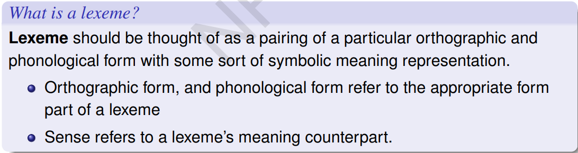
Solution
Answer: a
Solution:

Slide 12
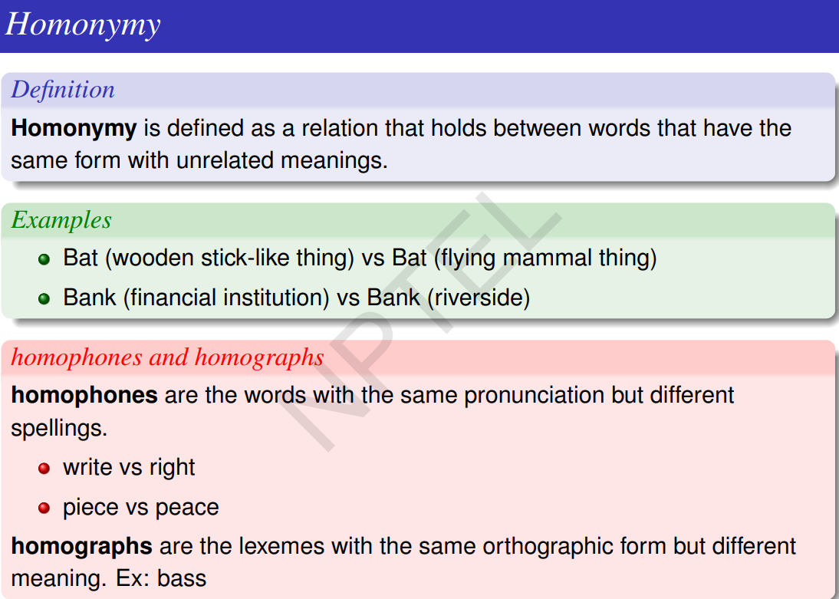

Slide 13
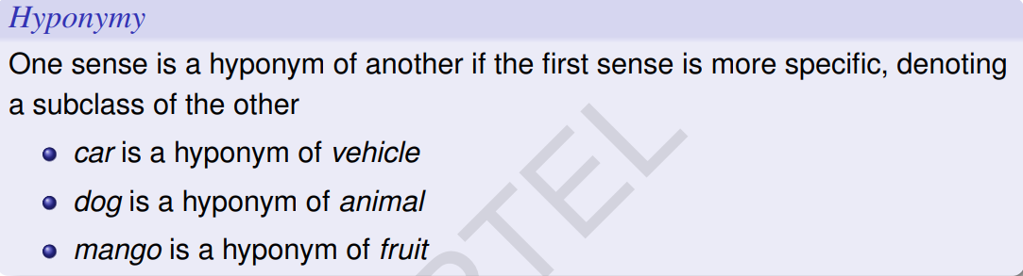
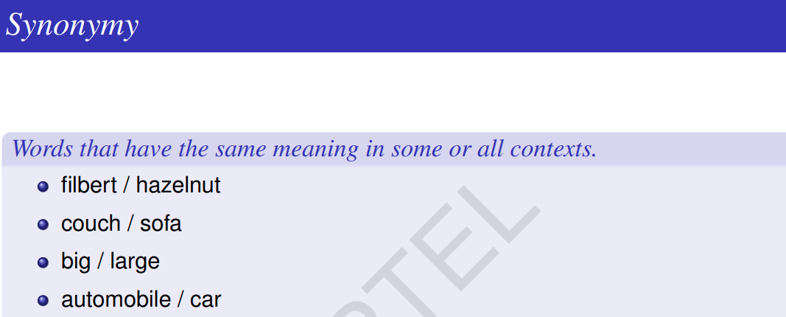

Slide 14
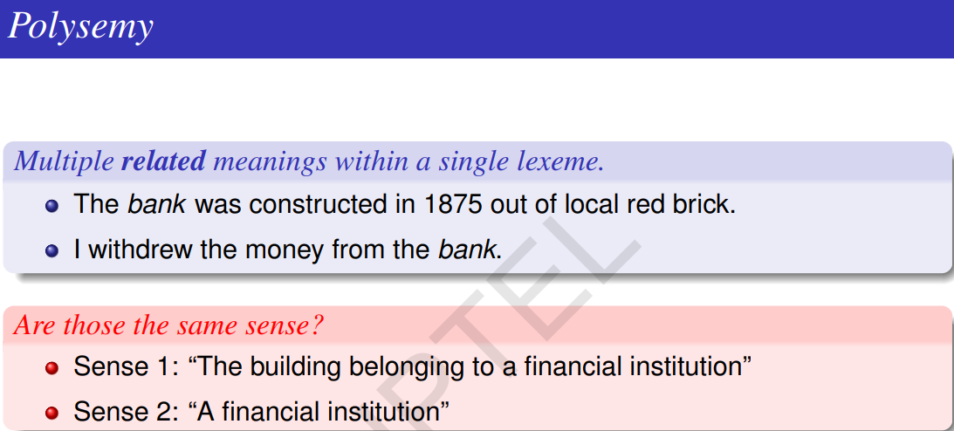

Slide 15
Question 2:
Consider the following sentences. Which of the following is/are True?
a. Dog is a hyponym of animal.
b. Fruit is a hypernym of apple.
c. Animal is hyponym of dog.
d. Guava is hypernym of fruit.

Slide 16
Solution
Answer: a, b
Solution:

Slide 17
Question 3:
Two concepts along with their glosses are given below. Find the similarity score between concepts “currency” and “money” with the Extended Lesk’s algorithm. (Note: Do not consider the stop words.)
currency : the metal or paper medium of exchange that is presently used
money : the most common exchange medium presently used
a. 2
b. 3
c. 6
d. 9

Slide 18
Solution
Answer: c
Solution:
currency : the metal or paper medium of exchange that is presently used
money : the most common exchange medium presently used
common words are : medium, exchange, presently used
score = 1^2 + 1^2 + 2^2= 6

Slide 19
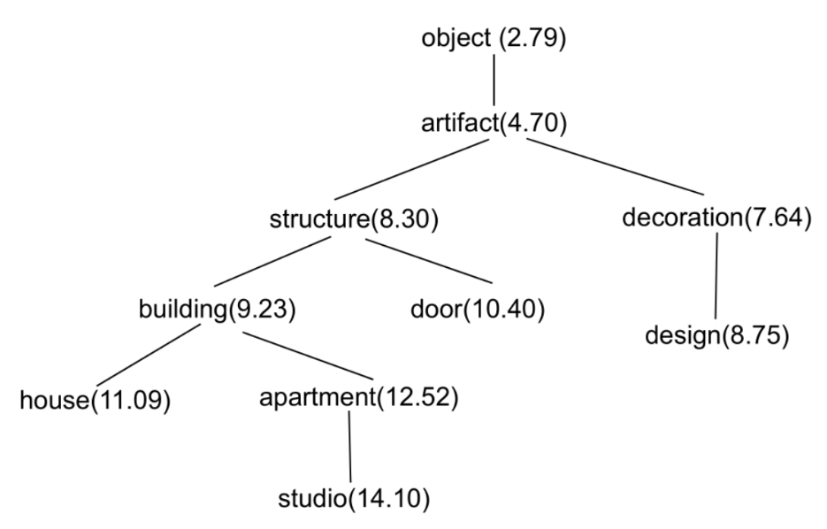
For Question 4 to 6, consider a hypothetical wordnet noun taxonomy with their information content as shown in Figure 1. Question 4 carries 2 marks.
Note: Use base 10 in logarithmic calculations

Slide 20
Question 4:
What is the Lin similarity between house and design?
a. 0.564
b. 0.433
c. 0.466
d. 0.473

Slide 21
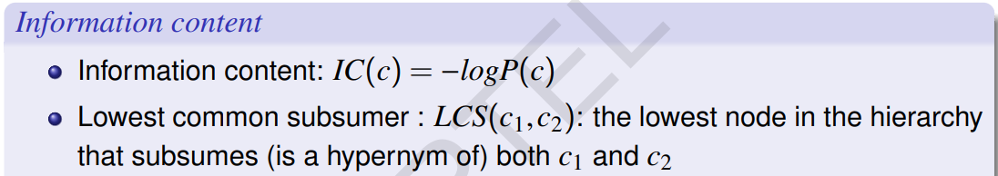
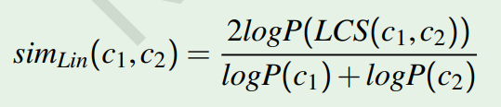
Solution
Answer: d
Solution: 2*IC(LCS(c₁,c₂))/(IC(c₁) + IC(c₂))
= 2*IC(artifact)/(IC(house) + IC(design)) = (2×4.7)/(11.09+8.75) ≈ 0.473

Slide 22
Question 5:
What is the Resnic similarity between building and door?
a. 11.09
b. 8.30
c. 9.23
d. 4.70

Slide 23
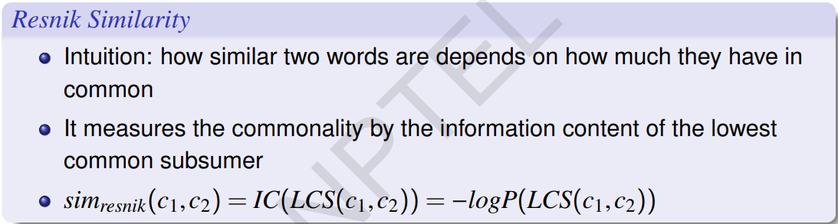
Solution
Answer: b
Solution: IC(LCS(c₁,c₂)) = IC(LCS(building,door) = IC(structure) = 8.30

Slide 24
Question 6:
What is the Leacock–Chodorow similarity between building and design?
a. 0.398
b. 0.699
c. 0.097
d. None of the above

Slide 25
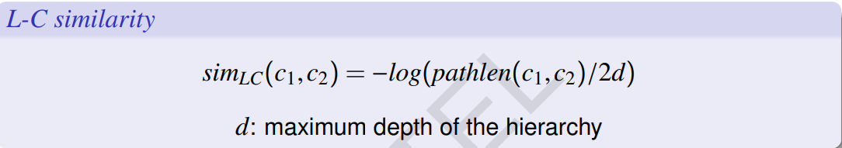
Solution
Answer: a
Solution:
LC similarity = −log pathlen(c1,c2)/2d = −log 4/(2×5) ≈ 0.398

Slide 26
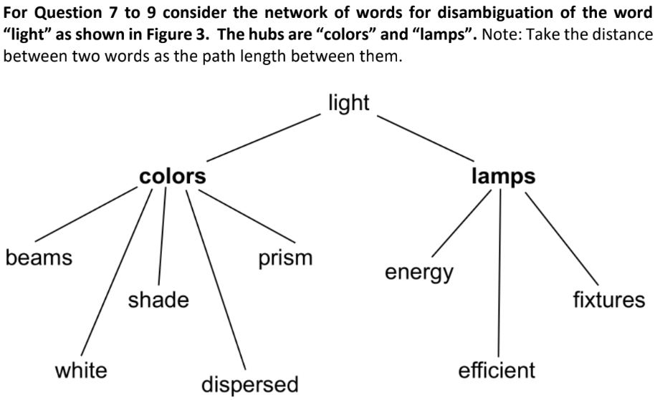

Slide 27
Question 7:
Compute the scores for (i) the hub “colors” and the component “white” and (ii) the hub “colors” and the component “fixtures”.
a. 0.2, 0.25
b. 1.0, 0.0
c. 0.5, 0.25
d. None of the above

Slide 28
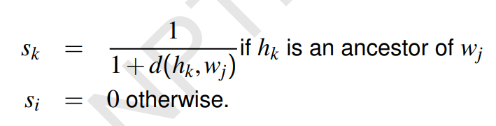
Solution
Answer: d
Solution:
(i) 1/(1+1) = 0.5
(ii) 0 as “colors” is not an ancestor of “fixtures”

Slide 29
Question 8:
What are the scores of the hubs “colors” and “lamps” respectively?
a. 0.6, 0.4
b. 0.20, 0.33
c. 2.5, 1.5
d. None of the above

Slide 30
Solution
Answer: c
Solution: Each component’s score is 0.5

Slide 31
Question 9:
Which is the most appropriate sense for the word “light”?
a. colors
b. lamps
c. both colors and lamps are appropriate
d. Not enough data

Slide 32
Solution
Answer: a
Solution: “colors” has the highest score

